Slide 1
Lecture 5 – Network Layer and IP Addressing
COMP1002 (Cybersecurity and Networks)

Slide 2
Overview
Network layer (CCNA1 - ch8)
The role of the Network layer - describe communication from one end device to another end device.
Internet Protocol (IP) and its features for providing connectionless and best-effort service.
Basic router configuration (ch10)
IPv4 addressing (ch11)
The division, or grouping, of devices into networks.
Hierarchical addressing of devices and how this allows communication between networks.
The fundamentals of routes, next-hop addresses, and packet forwarding to a destination network.

Slide 3
Part 1: Network Layer

Slide 4
Aim and objectives
Aim: the Network layer (OSI Layer 3) provides services to exchange the individual pieces of data over the network between identified end devices.
Basic processes:
Addressing
Encapsulation
Routing
Decapsulation

Slide 5
Processes
Addressing – provided addresses must be unique
Encapsulation – add src/dst address to each network layer PDU (packet)
Routing - provide services to direct the packets to their destination host
Decapsulation – extract content of the packet at the destination host

Slide 6
Protocols
Internet Protocol version 4 (IPv4)
Internet Protocol version 6 (IPv6)

Slide 7
IPv4
RFC791 – September 1981
The standard for the current Internet
IPv6 - only isolated and encapsulated in IPv4
IP - low overhead, only delivery of packets from source to destination over an interconnected network(s).
Characteristics
Connectionless - No connection is established before sending data packets.
Best Effort (unreliable) - No overhead is used to guarantee packet delivery.
Media Independent - Operates independently of the medium carrying the data.

Slide 8
Characteristics
Connectionless service = no prior notification of the recipient
No confirmation of arrival
Therefore, IP has:
No additional control fields in header
No control data
No knowledge of end-to-end delivery
Media independence = no specific requirements for the link layer
No strict packet size
No single transport medium
Best effort = No reliability
No guarantees about delivery
No capability to manage or recover from loss
Therefore, IP has no control fields in the header and no packet tracking

Slide 9
IPv4 header
0 1 2 3
0 1 2 3 4 5 6 7 8 9 0 1 2 3 4 5 6 7 8 9 0 1 2 3 4 5 6 7 8 9 0 1
+-+-+-+-+-+-+-+-+-+-+-+-+-+-+-+-+-+-+-+-+-+-+-+-+-+-+-+-+-+-+-+-+
|Version| IHL |Type of Service| Total Length |
+-+-+-+-+-+-+-+-+-+-+-+-+-+-+-+-+-+-+-+-+-+-+-+-+-+-+-+-+-+-+-+-+
| Identification |Flags| Fragment Offset |
+-+-+-+-+-+-+-+-+-+-+-+-+-+-+-+-+-+-+-+-+-+-+-+-+-+-+-+-+-+-+-+-+
| Time to Live | Protocol | Header Checksum |
+-+-+-+-+-+-+-+-+-+-+-+-+-+-+-+-+-+-+-+-+-+-+-+-+-+-+-+-+-+-+-+-+
| Source Address |
+-+-+-+-+-+-+-+-+-+-+-+-+-+-+-+-+-+-+-+-+-+-+-+-+-+-+-+-+-+-+-+-+
| Destination Address |
+-+-+-+-+-+-+-+-+-+-+-+-+-+-+-+-+-+-+-+-+-+-+-+-+-+-+-+-+-+-+-+-+
| Options | Padding |
+-+-+-+-+-+-+-+-+-+-+-+-+-+-+-+-+-+-+-+-+-+-+-+-+-+-+-+-+-+-+-+-+
Notes:
IHL: Internet Header Length. What is the minimum length of IPv4 header?

Slide 10
IPv4 fields
IP Source / Destination Address (32b)
Time-to-Live (TTL) (8b) - the remaining "life" of the packet.
Decreased by at least one each time the packet is processed by a router
When the value becomes zero, the router discards or drops the packet and it is removed from the network data flow.
This mechanism prevents routing loops

Slide 11
IPv4 fields (cont)
Protocol (8b) - data payload type
Enables Network layer to pass data to appropriate upper-layer protocol.
e.g.: 01 ICMP, 06 TCP, 17 UDP
Type-of-Service (TOS) (8b) – priority
To be used by Quality-of-Service (QoS)
Fragment Offset (13b)
Router may fragment a packet when forwarding it from one medium to another medium that has a smaller MTU.
IPv4 uses Fragment Offset and the MF flag to reconstruct the packet at the destination host.
More Fragments (MF) flag – (1b)
MF=1 - not the last fragment of a packet.
MF=0 – last fragment of a packet, reconstruct
Don't Fragment flag
DF=1 – fragmentation is not allowed
Notes:
MTU: maximum transmission unit. For Ethernet, MTU is 1500 bytes.

Slide 12
Transport across networks
If communication is between hosts in different networks, the local network delivers the packet from the source to its gateway router
Router examines the network portion of destination address and forwards the packet to the appropriate interface.
If destination network is directly connected, the packet is forwarded directly to that host.
If the destination network is not directly connected, the packet is forwarded to a second router (next-hop router)
At each hop, the forwarding decisions are based on the information in the IP packet header

Slide 13
Routing
No packet can be forwarded without a route - the device must have a route to identify where to forward the packet.
A host must either forward a packet to the host on the local network or to the gateway, as appropriate
The host must have routes that represent these destinations.
A router makes a forwarding decision for each packet that arrives at the gateway interface.
This forwarding process is referred to as routing.
The destination network may be a number of routers or hops away from the gateway.
The route only indicates the next-hop router, not the final router.

Slide 14
Forwarding process
Routing - packet-by-packet and hop-by-hop.
Each packet is treated independently in each router along the path.
Examine destination IP address and check routing table for forwarding information.
The router will either:
Forward packet to the next-hop router
Forward packet to the destination host
Drop packet

Slide 15
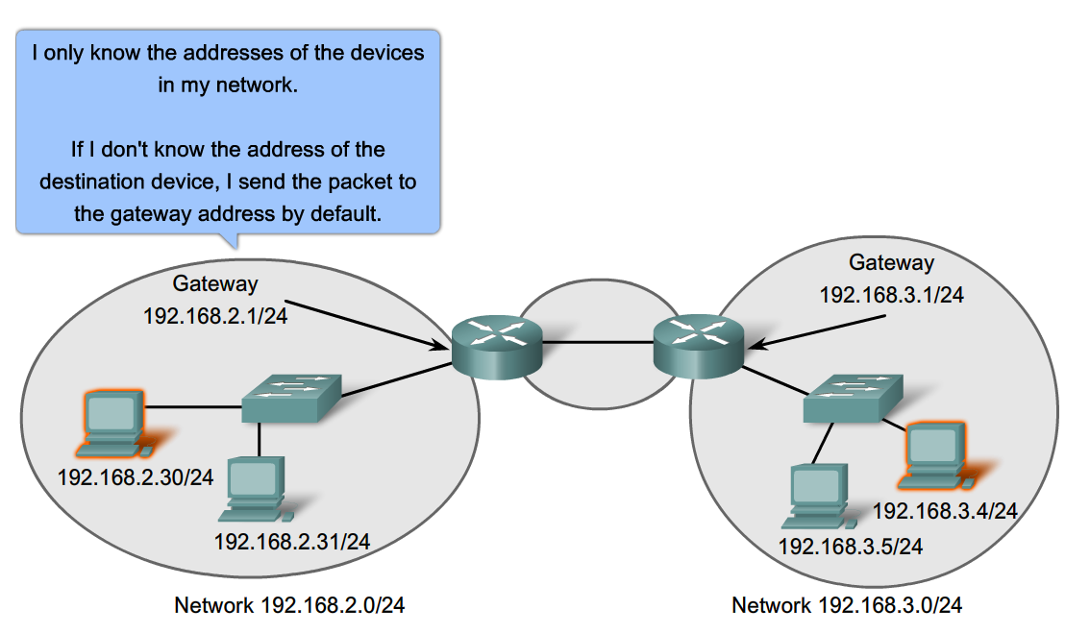
Using the gateway

Slide 16
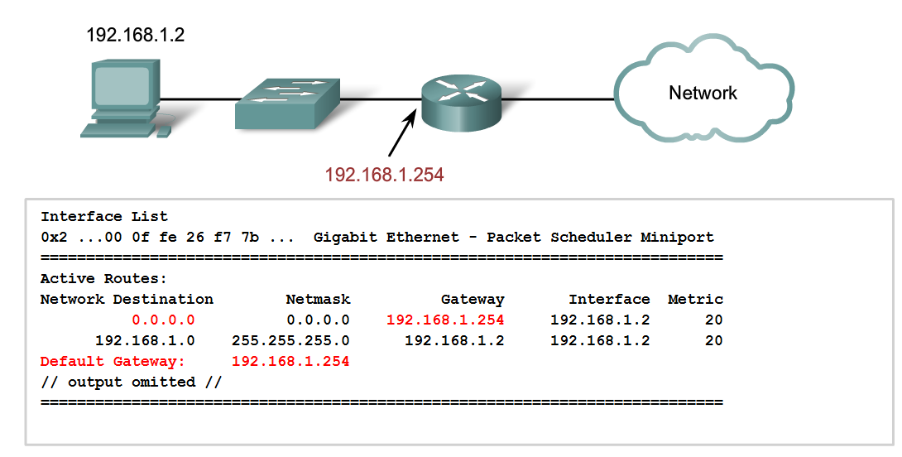
IPv4 routing table – host

Slide 17
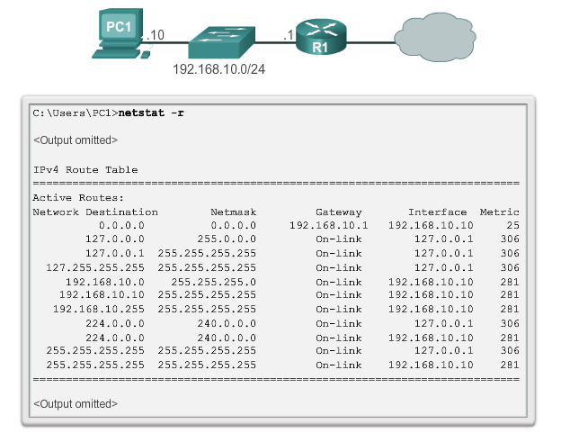
IPv4 routing table – host
Network Destination - reachable networks.
Netmask - determine the network and the host portions of the IP address.
Gateway - address used by the local computer to get to a remote network destination. If a destination is directly reachable, it will show as “on-link” in this column.
Interface - address of the physical interface used to send the packet to the gateway that is used to reach the network destination.
Metric - cost of each route and is used to determine the best route to a destination.
Notes:
For a host, it can receive the default gateway address from DHCP (Dynamic Host Configuration Protocol) or configure manually.

Slide 18
IPv4 routing table - host
0.0.0.0 - default route
127.0.0.0 – 127.255.255.255 – loopback
192.168.10.0 - 192.168.10.255 – local network
192.168.10.0 - The local network route address
192.168.10.10 - The address of the local host.
192.168.10.255 - The network broadcast address
224.0.0.0 - multicast class D addresses
255.255.255.255 – limited broadcast IP address values for loopback interface (127.0.0.1) or the host IP address (192.168.10.10)

Slide 19
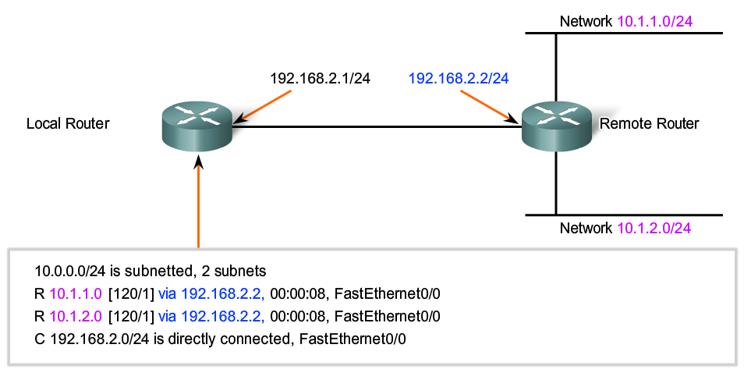
Routing tables

Slide 20
Routing table - router
Directly-connected routes – from active router interfaces.
Added when an interface is configured/activated with an IP address
Remote routes - from remote networks connected to other routers.
Either be manually configured on the local router by the network administrator or dynamically configured by enabling the local router to exchange routing information with other routers using dynamic routing protocols.

Slide 21
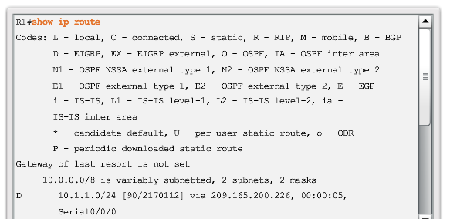
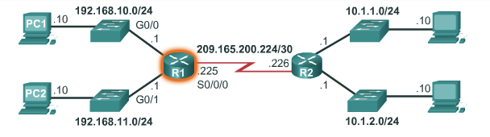
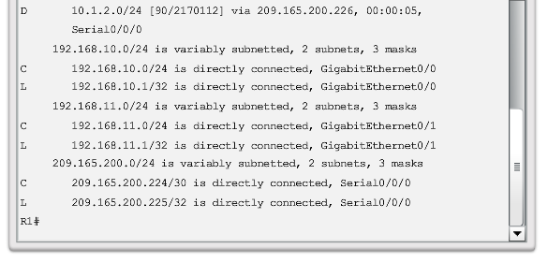
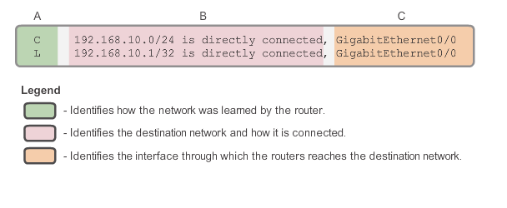
Routing table - router

Slide 22
Routing table - router
Directly connected interfaces
C - directly connected network, automatically created when an interface is configured with an IP address and activated.
L - link local route, automatically created when an interface is configured with an IP address and activated.
Remote networks
S - route was manually created by an administrator to reach a specific network. This is known as a static route.
D - route was learned dynamically from another router using the Enhanced Interior Gateway Routing Protocol (EIGRP).
O - route was learned dynamically from another router using the Open Shortest Path First (OSPF) routing protocol.

Slide 23
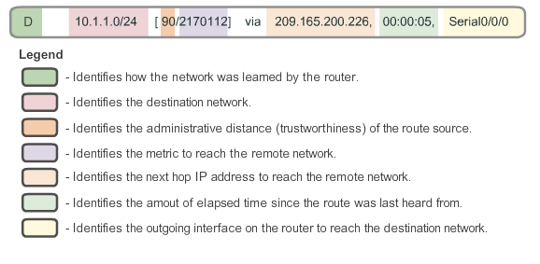
Routing table – router
Route source - Identifies how the route was learned.
Destination network - Identifies the address of the remote network.
Administrative distance - Identifies the trustworthiness of the route source.
Metric - value assigned to reach the remote network - lower values indicate preferred routes.
Next-hop - Identifies the IP address of the next router to forward the packet.
Route timestamp - Identifies when the route was last heard from
Outgoing interface - exit interface to forward a packet to final destination.

Slide 24
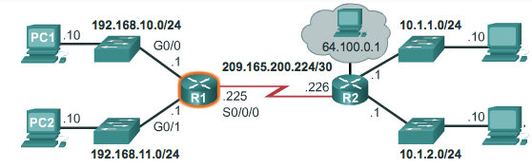
Routing examples
PC1 to 192.168.10.1
PC1 to 192.168.11.10
PC1 to 209.165.200.226
PC1 to 10.1.1.10

Slide 25
IOS
Internetworking Operating System
used by Cisco in its routers
Certain models include a GUI, but typical configuration is done via CLI
At boot:
startup-config (NVRAM) is copied into RAM and stored as the running-config file.
IOS executes running-config.
Any changes are stored in running-config and are immediately implemented by the IOS
Notes:
Non-Volatile RAM: the data will not be lost when power down.

Slide 26
Interfaces
Management ports
Console port – serial communication
Auxiliary port – similar to console, also modem
Network ports
LAN - Ethernet/Fast Ethernet
Enhanced high-speed WAN interface card (EHWIC) slots - provide modularity and flexibility by enabling the router to support different types of interface modules, including Serial, digital subscriber line (DSL), switch port, and wireless.

Slide 27
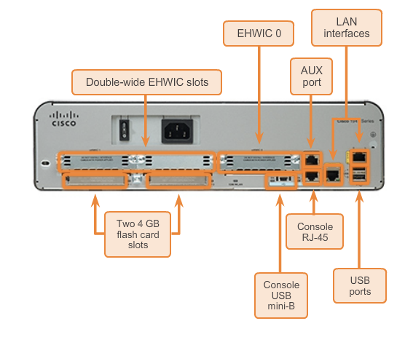
Interfaces

Slide 28
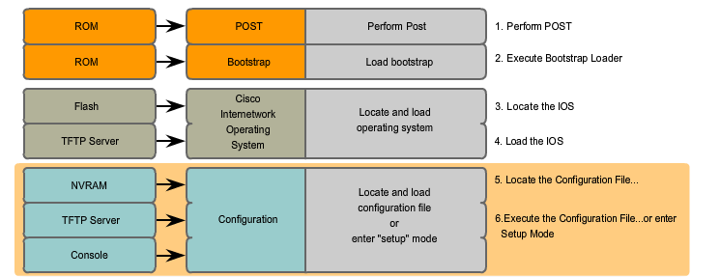
Boot process
Notes:
POST: power on self test

Slide 29
Boot process
Performing POST (Power On Self Test)
Test router hardware
Loading the bootstrap program
Copy bootstrap from ROM to RAM and execute
Locate and load the Cisco IOS software
IOS can be stored on flash, tftp server, etc
Copy/extract IOS from flash into RAM
Locate and load startup configuration
NVRAM, tftp server,etc
If not found – router may go into setup mode
CLI (Command Line Interface)
The content of the router may be seen using the show version command

Slide 30
Routing process
Router examines the destination IP of each received packet and decides what to do with it based on a routing table
Match found
Directly connected to the network – send the packet to destination
Not directly connected – forward it to another router
No match found – drop the packet
Routing – layer 3 (based on IP addresses)
Routers operate at layers 1,2, and 3

Slide 31
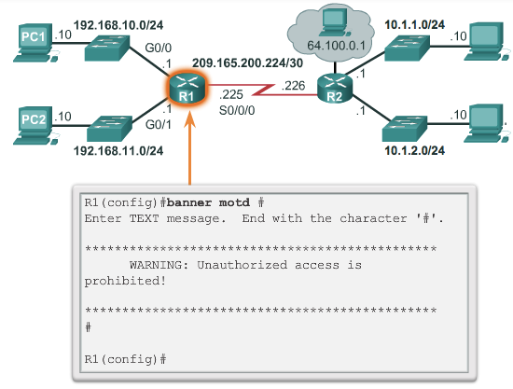
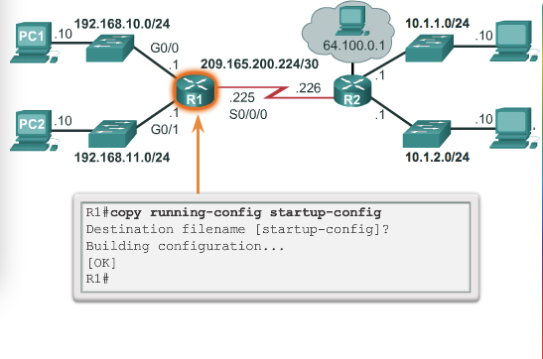
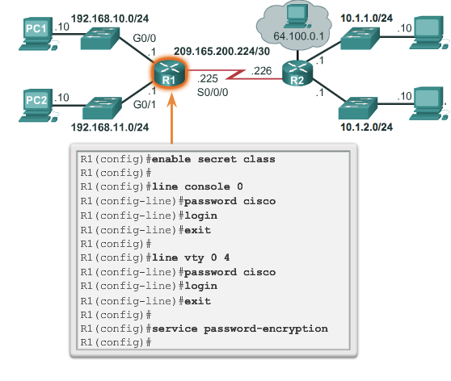
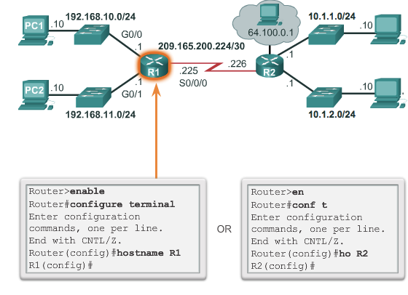
Basic router configuration

Slide 32
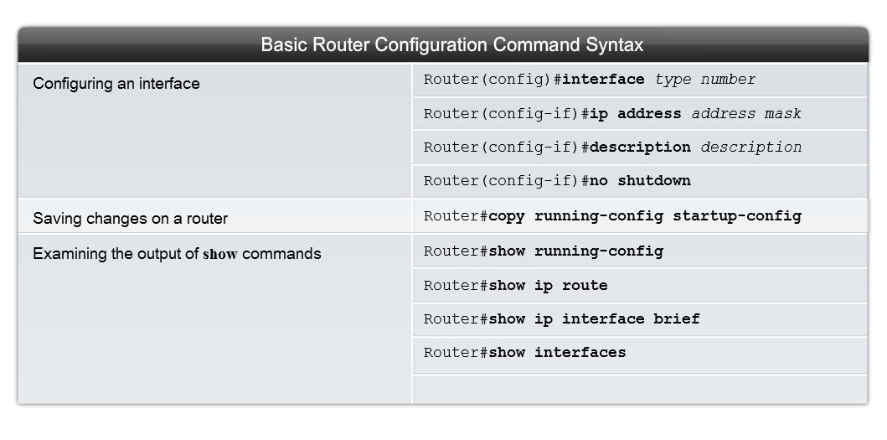
Interface configuration

Slide 33
View/verify configuration
View running/startup config
R1#show running-config
R1#show startup-config
Copy running config to startup config
R1#copy running-config startup-config
View current routing table and interface status
R1#show ip route
R1#show interfaces
R1#show ip interface brief

Slide 34
Configure default gateway
Host
Part of the interface configuration
Switch
S1(config)# interface vlan1
S1(config-vlan)# ip address 192.168.10.50 255.255.255.0
S1(config-vlan)# no shut
S1(config)# ip default-gateway 192.168.10.1

Slide 35
Summary
Network layer – carry data over the network
Routing table – core/essential
IPv4
Default gateway – connecting the network with the rest of the internet/Internet
Router architecture – CPU, memory, storage, interfaces
Basic configuration of a router

Slide 36
Lab activities
10.1.4 – Configure initial router settings

Slide 37
Go to www.menti.com and use the code 5652 3480

Slide 38
Part 2: IP Addressing

Slide 39
Overview
Explain the structure IP addressing
Classify IPv4 addresses by type
Explain how IP address are assigned to networks
Determine the network portion of the host address and explain the role of the subnet mask in dividing networks.
Calculate the appropriate addressing components, given IPv4 addressing information and design criteria,.
Use common testing utilities to verify and test network connectivity and operational status of the IP protocol stack on a host.

Slide 40
Representation
Binary (as in IP header)
10101100000100000000010000010100
Dotted decimal
172.16.4.20
Network and host portion (for a /16 netmask)
172.16.4.20

Slide 41
Binary-decimal conversion
The number: 245
a.k.a. 11110101
(a.k.a. f5)
Decimal representation
245 = 2⋅10² + 4⋅10¹ + 5⋅10⁰
Binary representation
11110101 = 1⋅2⁷ + 1⋅2⁶ + 1⋅2⁵ + 1⋅2⁴ + 0⋅2³ + 1⋅2² + 0⋅2¹ ⁺ 1⋅2⁰
= 128 + 64 + 32 + 16 + 4 + 1

Slide 42
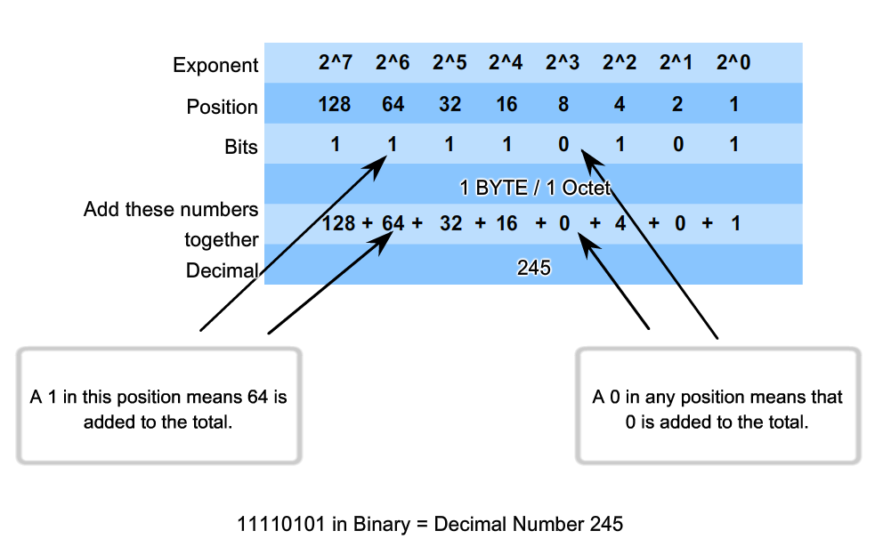
Binary-decimal conversion (cont)

Slide 43
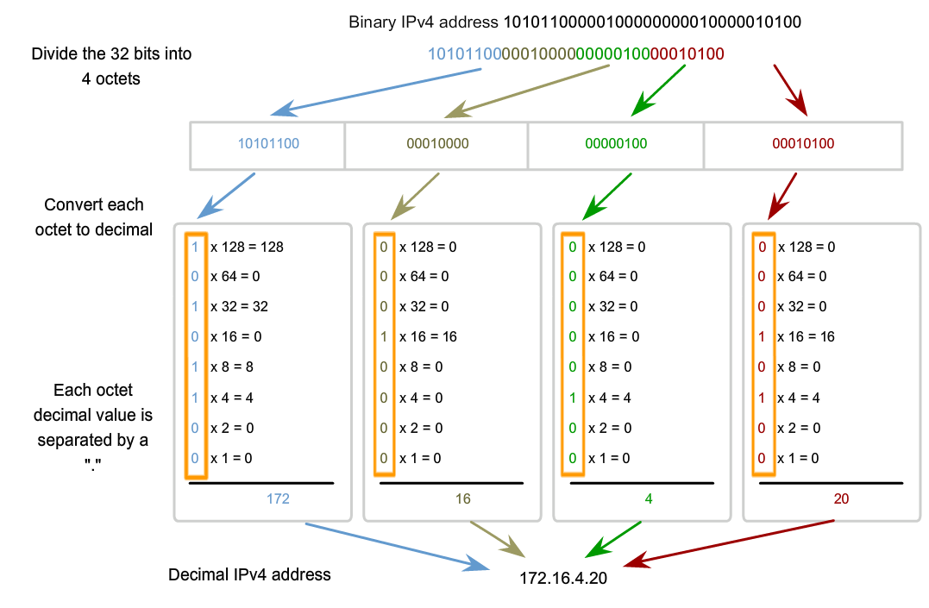
Binary-decimal conversion (cont)

Slide 44
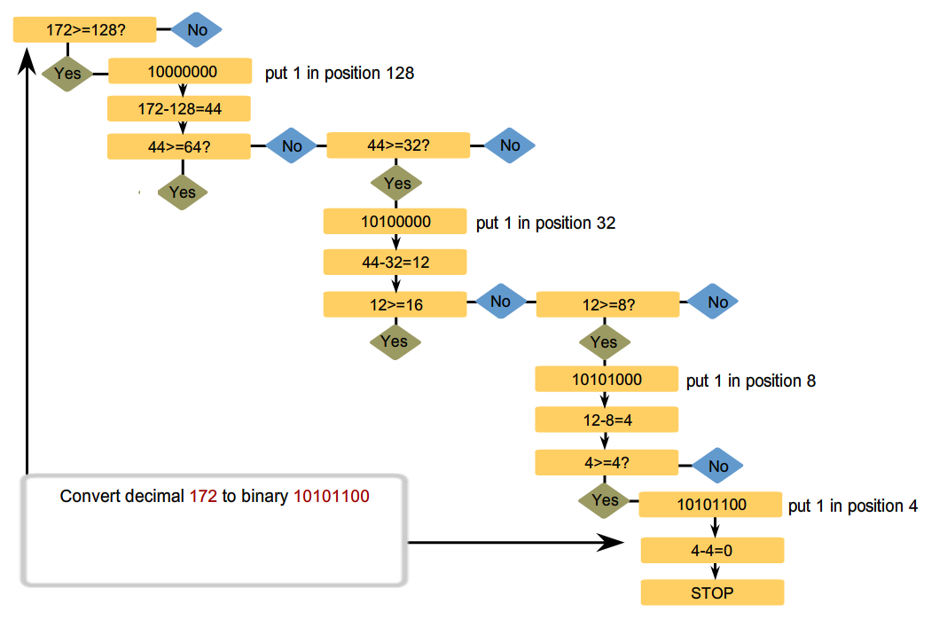
Binary-decimal conversion (cont)

Slide 45
Addresses within a (sub)net
Network address - The address by which we refer to the network
All host bits are 0
Broadcast address - A special address used to send data to all hosts in the network
All host bits are 1
Host addresses - The addresses assigned to the end devices in the network
From all-zeroes to all-ones
Network prefix: the number of bits in the address that gives us the network portion

Slide 46
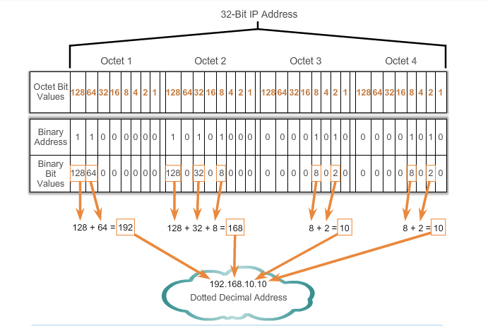
Binary-decimal/octet conversion

Slide 47
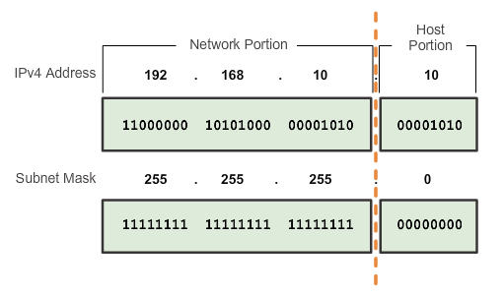
Network and host part
The network portion bits of the address - identical for all devices that reside in the same network.

Slide 48
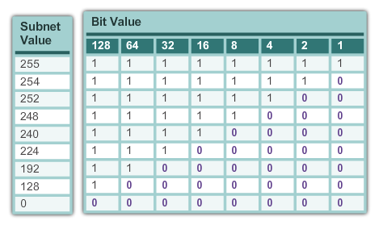
Netmask
Defines the size of the network part
1…10…0
The 1s in the subnet mask represent the network portion; the 0s represent the host portion

Slide 49
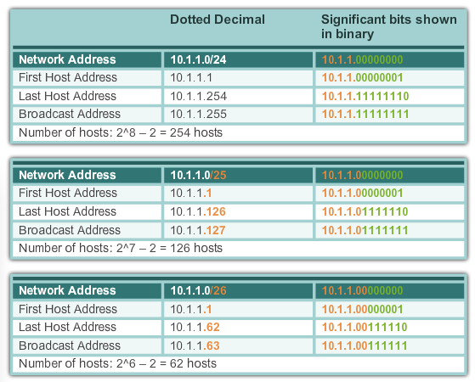
Network prefixes

Slide 50
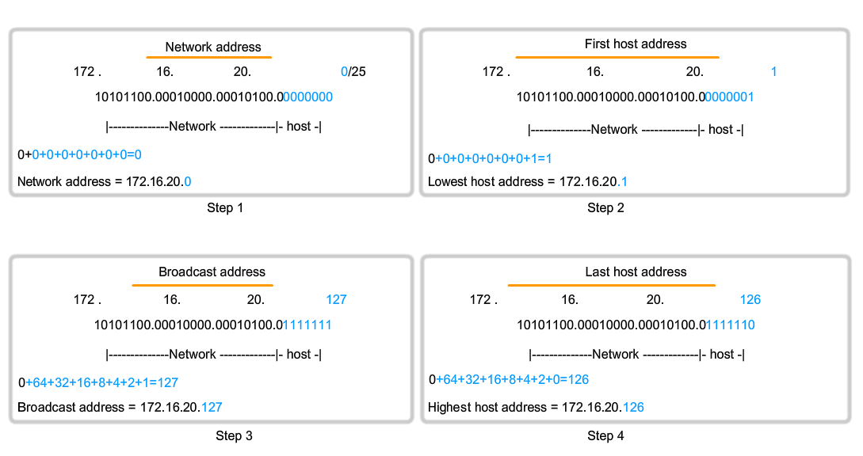
172.16.20.0/25

Slide 51
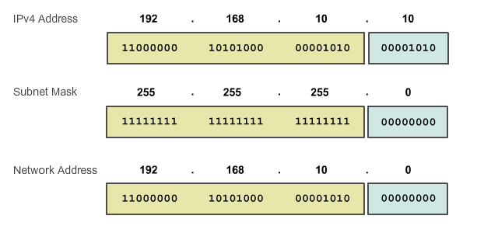
Identify network address - ANDing

Slide 52
Assigning IP addresses in a LAN
Static – manual
Dynamic - DHCP

Slide 53
Communication
Unicast - one host to one host
Typical communication
Broadcast - one host to all hosts in the network
Directed – can be used remotely – using the broadcast address
Limited – local network – using the 255.255.255.255 address
Multicast - one host to a selected group of hosts
Reduce overall bandwidth (one packet for all listening hosts)
Multicast clients subscribe to a group
Uses (reserved) addresses: 224.0.0.0 – 239.255.255.255

Slide 54
Reserved IP ranges
Multicast (RFC1700)
224.0.0.0 – 239.255.255.255
Experimental: (RFC1700, RFC3330)
240.0.0.0 – 255.255.255.254
Private/Network Address Translation (RFC1918)
10.0.0.0 to 10.255.255.255 (10.0.0.0 /8)
172.16.0.0 to 172.31.255.255 (172.16.0.0 /12)
192.168.0.0 to 192.168.255.255 (192.168.0.0 /16)
Link local
169.254.0.0 to 169.254.255.255 (169.254.0.0/16)
Test-net (teaching/learning)
192.0.2.0 to 192.0.2.255 (192.0.2.0/24)

Slide 55
Special IPv4 addresses
Network and broadcast addresses
All-zeroes and all-ones host bits
Default route
0.0.0.0
Loopback
127.0.0.1

Slide 56
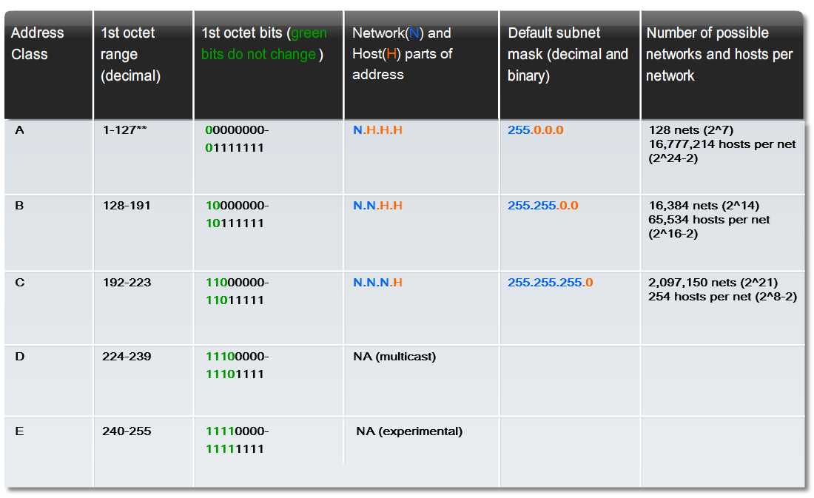
Legacy IP addressing

Slide 57
Network address planning
Criteria:
Preventing duplication of addresses
Providing and controlling access
Monitoring security and performance
Allocation
Static – manual
Servers and routers
Dynamic – automatic
Using DHCP

Slide 58
Assigning IP addresses
Level 0: the Internet - IANA
Level 1: Regional Internet Registries
Level 3: ISPs
Level 4: Network administrators

Slide 59
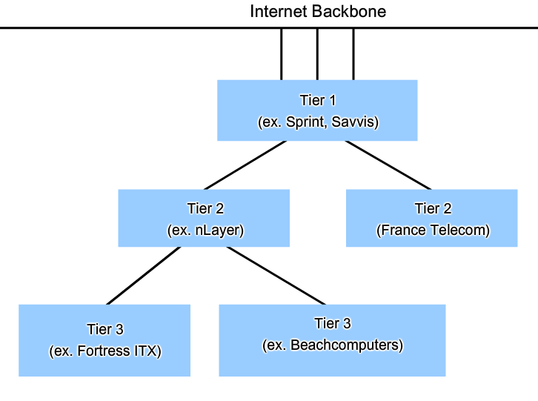
Internet tiers

Slide 60
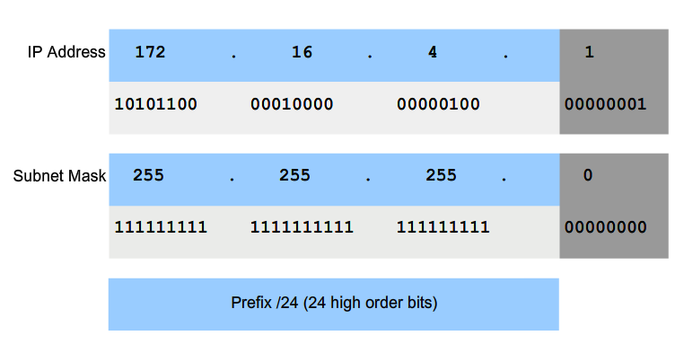
Subnet mask
Defines the network and host portions

Slide 61
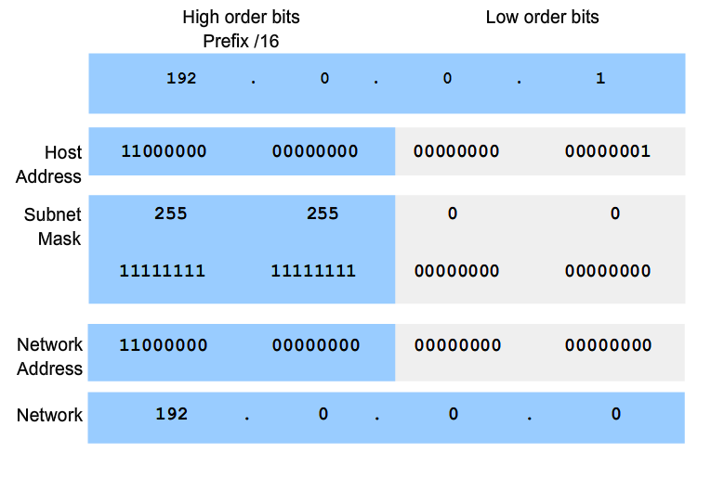
Applying the subnet mask – ANDing

Slide 62
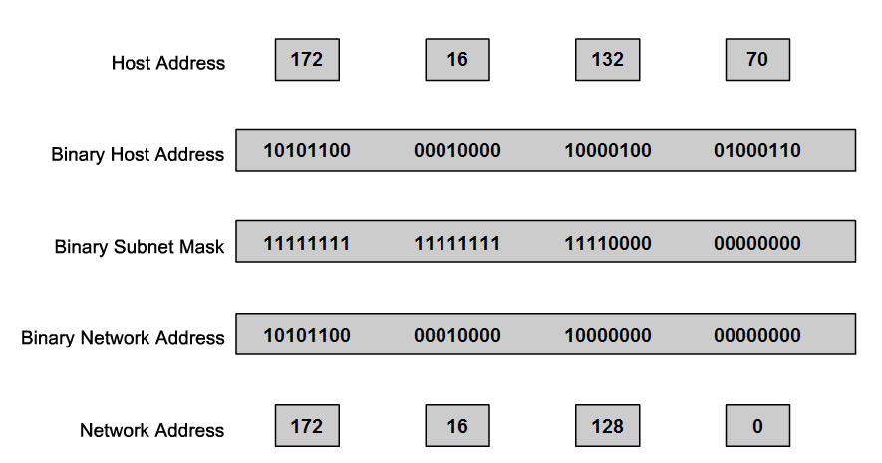
ANDing example
Network address for host 172.16.132.70/20

Slide 63
Ping and traceroute
Loopback
Local network
Remote device
Traceroute
Sends packets with increasing TTL values
Forces time exceeded replies from routers along the route

Slide 64
Activities
5.1.6 / 5.1.7 – Binary-decimal conversion
https://learningcontent.cisco.com/games/binary/index.html
11.1.7 - ANDing to Determine the Network Address

